Slide 1
Design of Sysconf, Pathconf, fpathconf and two basic unix commands
Submitted by:
Aditya Nandeshwar
Atreay Kukanur
Aniketh Mahadik
Fakkiresh Noorshetter

Slide 2
sysconf - get configurable system variables
SYNOPSIS
#include <unistd.h>
long sysconf(int name);
DESCRIPTION
The sysconf() function provides a method for the application to determine the current value of a configurable system limit or option ( variable). The implementation shall support all of the variables listed in the following table and may support others.
The name argument represents the system variable to be queried. The following table lists the minimal set of system variables from <limits.h> or <unistd.h> that can be returned by sysconf(), and the symbolic constants defined in <unistd.h> that are the corresponding values used for name.

Slide 3
_SC_ARG_MAX [ARG_MAX]
The maximum length of the argument list to the exec() family of functions, including environment data.
_SC_AIO_MAX [AIO_MAX]
The maximum number of outstanding asynchronous I/O operations.
_SC_TIMERS
The _POSIX_TIMERS value
_SC_DELAYTIMER_MAX
Maximum number of overruns allowed per timer
_SC_RTSIG_MAX
Maximum number of real time signals

Slide 4
RETURN VALUE
If name is an invalid value, sysconf() shall return -1 and set errno to indicate the error. If the variable corresponding to name has no limit, sysconf() shall return -1 without changing the value of errno. Note that indefinite limits do not imply infinite limits; see <limits.h>.
Otherwise, sysconf() shall return the current variable value on the system. The value returned shall not be more restrictive than the corresponding value described to the application when it was compiled with the implementation's <limits.h> or <unistd.h>. The value shall not change during the lifetime of the calling process, except that sysconf(_SC_OPEN_MAX) may return different values before and after a call to setrlimit() which changes the RLIMIT_NOFILE soft limit.
If the variable corresponding to name is dependent on an unsupported option, the results are unspecified.

Slide 5
Implementation:
#define _POSIX_SOURCE
#define _POSIX_C_SOURCE 199309L
#include<stdio.h>
#include<unistd.h>
#include<iostream.h>
int main()
{
int res;
if((res=sysconf(_SC_TIMERS)) == -1)

Slide 6
perror("sysconf");
else
cout <<"_POSIX_TIMERS value: "<<res<<endl;
if((res=sysconf(_SC_DELAYTIMER_MAX)) == -1)
perror("sysconf");
else
cout <<"Maximum no. of overuns allowed: "<<res<<endl;
if((res=sysconf(_SC_RTSIG_MAX)) == -1)
perror("sysconf");

Slide 7
else
cout <<"Maximum no. of real time signals: "<<res<<endl;
return 0;
}

Slide 8
fpathconf, pathconf - get configurable pathname variables
SYNOPSIS
#include <unistd.h>
long fpathconf(int fildes, int name);
long pathconf(const char *path, int name);
DESCRIPTION
The fpathconf() and pathconf() functions shall determine the current value of a configurable limit or option (variable) that is associated with a file or directory.
For pathconf(), the path argument points to the pathname of a file or directory.
For fpathconf(), the fildes argument is an open file descriptor.
The name argument represents the variable to be queried relative to that file or directory. Implementations shall support all of the variables listed in the following table and may support others. The variables in the following table come from <limits.h> or <unistd.h> and the symbolic constants, defined in <unistd.h>, are the corresponding values used for name.

Slide 9
_PC_PIPE_BUF
Maximum size of a block of data that may be automatically read from or written to a pipe file
_PC_MAX_INPUT
Maximum capacity in bytes of a terminal’s input queue
_PC_AIX_DISK_PARTITION
Determines the physical partition size of the disk.
_PC_AIX_DISK_SIZE
Determines the disk size in megabytes.
_PC_FILESIZEBITS
Returns the minimum number of bits required to hold the file system's maximum file size as a signed integer. The smallest value returned is 32.
_PC_SYNC_IO
Returns -1 if the file system does not support the Synchronized Input and Output option. Any value other than -1 is returned if the file system supports the option.

Slide 10
Requirements
1. If path or fildes refers to a directory, the value returned shall apply to the directory itself.
2. If path or fildes does not refer to a terminal file, it is unspecified whether an implementation supports an association of the variable name with the specified file.
3. If path or fildes refers to a directory, the value returned shall apply to filenames within the directory.
4. If path or fildes does not refer to a directory, it is unspecified whether an implementation supports an association of the variable name with the specified file.
5. If path or fildes refers to a directory, the value returned shall be the maximum length of a relative pathname when the specified directory is the working directory.

Slide 11
6. If path refers to a FIFO, or fildes refers to a pipe or FIFO, the value returned shall apply to the referenced object. If path or fildes refers to a directory, the value returned shall apply to any FIFO that exists or can be created within the directory. If path or fildes refers to any other type of file, it is unspecified whether an implementation supports an association of the variable name with the specified file.
7. If path or fildes refers to a directory, the value returned shall apply to any files, other than directories, that exist or can be created within the directory.
8. If path or fildes refers to a directory, it is unspecified whether an implementation supports an association of the variable name with the specified file.
9. If path or fildes refers to a directory, the value returned shall be the maximum length of the string that a symbolic link in that directory can contain.
10. If path or fildes des does not refer to a regular file, it is unspecified whether an implementation supports an association of the variable name with the specified file. If an implementation supports such an association for other than a regular file, the value returned is unspecified.

Slide 12
RETURN VALUE
If name is an invalid value, both pathconf() and fpathconf() shall return -1 and set errno to indicate the error.
If the variable corresponding to name has no limit for the path or file descriptor, both pathconf() and fpathconf() shall return -1 without changing errno. If the implementation needs to use path to determine the value of name and the implementation does not support the association of name with the file specified by path, or if the process did not have appropriate privileges to query the file specified by path, or path does not exist, pathconf() shall return -1 and set errno to indicate the error.
If the implementation needs to use fildes to determine the value of name and the implementation does not support the association of name with the file specified by fildes, or if fildes is an invalid file descriptor, fpathconf() shall return -1 and set errno to indicate the error.
Otherwise, pathconf() or fpathconf() shall return the current variable value for the file or directory without changing errno. The value returned shall not be more restrictive than the corresponding value available to the application when it was compiled with the implementation's <limits.h> or <unistd.h>.
If the variable corresponding to name is dependent on an unsupported option, the results are unspecified.

Slide 13
Implementation:
define _POSIX_SOURCE
#define _POSIX_C_SOURCE 199309L
#include<stdio.h>
#include<unistd.h>
#include<iostream.h>
int main()
{
int res;
if((res=pathconf(“/”,_PC_MAX_INPUT))== -1)

Slide 14
perror("pathconf");
else
cout <<"Maximum capacity of terminal’s input queue: "<<(res+1)<<endl;
if((res=pathconf(“/”,_PC_PIPE_BUF))== -1)
perror("pathconf");
else
cout <<"Maximum size of a block of data that maybe written or read:” <<(res+1)<<endl;
if((res=pathconf(“/”,_PC_AIX_DISK_SIZE))== -1)
perror("pathconf");

Slide 15
else
cout <<"Determines the disk size in megabytes: "<<(res+1)<<endl;
return 0;
}

Slide 16
ERRORS
The pathconf() function shall fail if:
[EINVAL]
The value of name is not valid.
[EACCES]
Search permission is denied for a component of the path prefix.
[ENOENT]
A component of path does not name an existing file or path is an empty string.
[EBADF]
The files argument is not a valid file descriptor.

Slide 17
Basic Commands in Unix :
1.cat
Creating & Viewing Files
The ‘cat’ server command is used to display text files. It can also be used for copying, combining and creating new text files. Let’s see how it works.
To create a new file, use the command
1. cat > filename
2. Add content
3. Press ‘ctrl + d’ to return to command prompt.

Slide 18
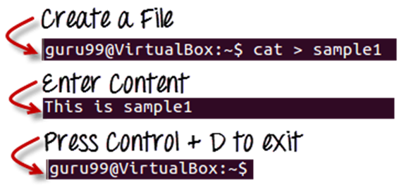
To view a file, use the command –
cat filename
Let’s see the file we just created –

Slide 19
Let’s see another file sample2
The syntax to combine 2 files is –
cat file1 file2 > newfilename
Let’s combine sample 1 and sample 2.

Slide 20

As soon as you insert this command and hit enter, the files are concatenated, but you do not see a result. This is because Bash Shell (Terminal) is silent type. Shell Commands will never give you a confirmation message like “OK” or “Command Successfully Executed”. It will only show a message when something goes wrong or when an error has occurred.
To view the new combo file “sample” use the command
cat sample

Slide 21
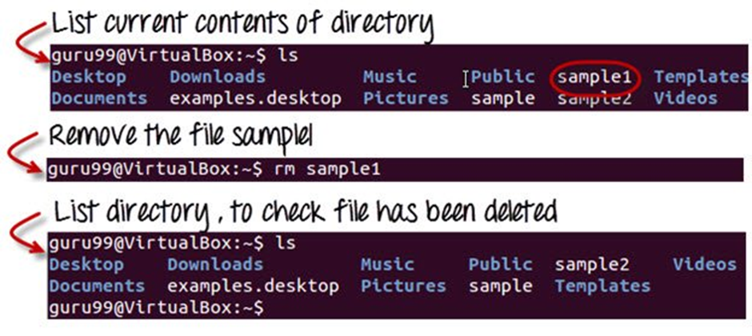
2.rm
Deleting Files
The ‘rm’ command removes files from the system without confirmation.
To remove a file use syntax –
rm filename

Slide 22
THANK YOU

